Slide 1
Natural Language Toolkit
Jackson Cown, Albert You

Slide 2

Origin
Created by Edward Loper, Ewan Klein, and Steven Bird
Classification, tokenization, stemming, tagging, lemmatization, parsing, and semantic reasoning
Suitable for linguists, engineers, students, reducators, researchers, and industry users
Bird, Steven, Edward Loper and Ewan Klein (2009), Natural Language Processing with Python. O’Reilly Media Inc.

Slide 3
Major Features
Lexical Analysis
I.e., Word Tokenization: Converting a sequence of characters into a sequence of tokens for use in computation
N-gram calculations
Statistical, probabilistic representations of contiguous sequences of ‘n’ characters in text
Collocation
Collections of words in a corpus which occur besides each other more often than just chance
Part-of-Speech tagging
Marking each words specific part-of-speech for use in analysis further down the processing pipeline
Text Chunking
Non-overlapping segmentation of labels and multi-token sequences
Named-Entity-Recognition
Locate and classify named entities mentioned in unstructured text into predefined categories
Lemmatization and Stemming
Distills similar words down to the same base word for better statistical analysis

Slide 4
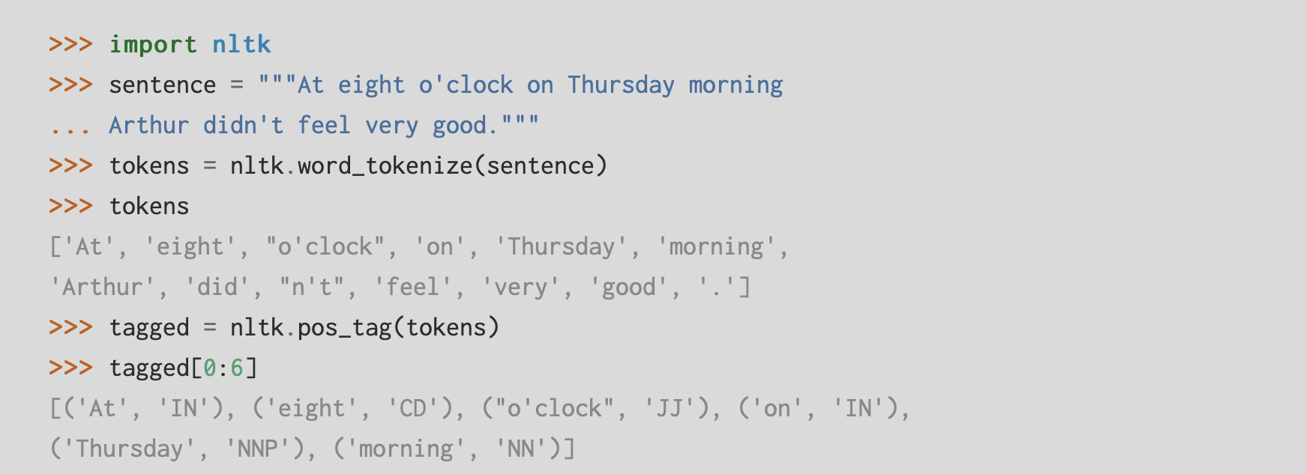
Tokenizing Example
https://www.nltk.org

Slide 5
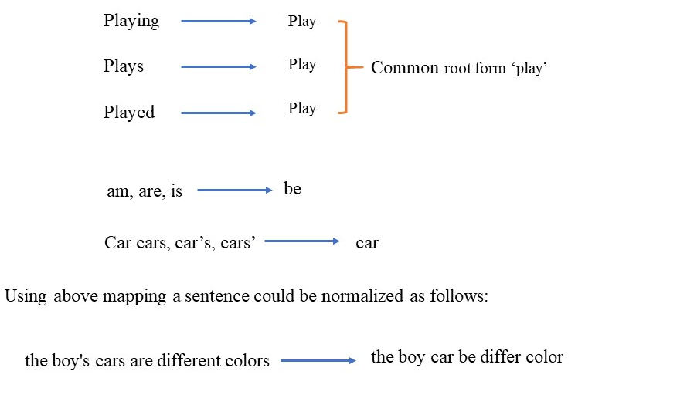
Lemmatization Example
Word lemmatization can be enhanced with part of speech tagging

Slide 6
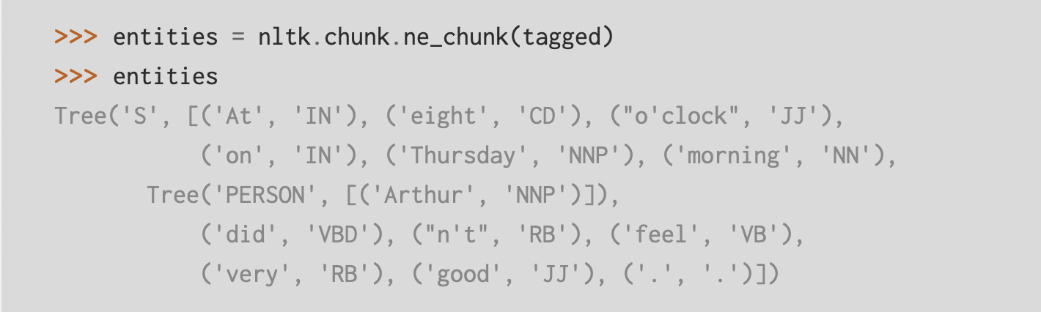
Entity Identification Example
https://www.ling.upenn.edu/courses/Fall_2003/ling001/penn_treebank_pos.html
https://www.nltk.org

Slide 7
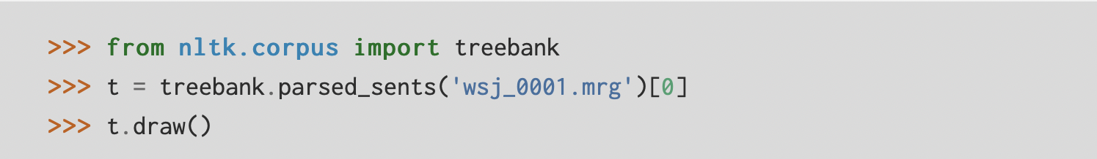
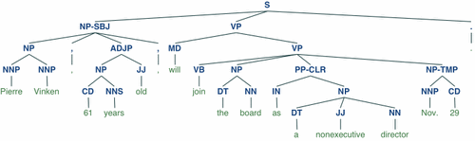
Parse Tree Display
https://www.nltk.org

Slide 8
Reference
NLTK Book: Bird, Steven, Edward Loper and Ewan Klein (2009), Natural Language Processing with Python. O’Reilly Media Inc.
https://www.nltk.org/book/

